Slide 1
DATA SCIENCE
PREDICTING EMOTIONS
FROM SPEECH SIGNALS AND TEXT
2277044 LEESEUNGHYEON
2491007 KIMYEEUN
2491021 LEEBADA
2491036 JUTAEIN

Slide 2
PROJECT
INDEX
01
02
03
04
05
06
07
08
Problem Definition
Data Review
Preprocessing
Improving Method - Data
Model Comparison
Improving Method - Modeling
Final Result
Q&A

Slide 3
PROBLEM DEFINITION
Business Value

Slide 4





BACKGROUND
...
English
Korean
Increasing
Usage Of ChatGPT
Shortage Of
Korean Detection Model

Slide 5




BACKGROUND
Korean speech datasets
nonverbal speech signal
textual cues
Detecting emotinal state

Slide 6

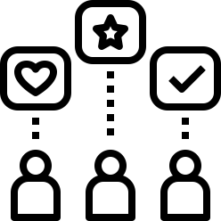

PROBLEM DIFINITION
Detecting emotinal state
integration with
wearable devices
personalized feedback
delivery
real-time emotion prediction

Slide 7
DATA REVIEW
DATA

Slide 8

DATA ACQUISITION
by the KAIST Artificial Intelligence Research Institute

Slide 9




DATA REVIEW
happiness
angry
19,374 Korean wav file
fear
neutral
disgust
Labeled by 5 people
sadness
surprise

Slide 10
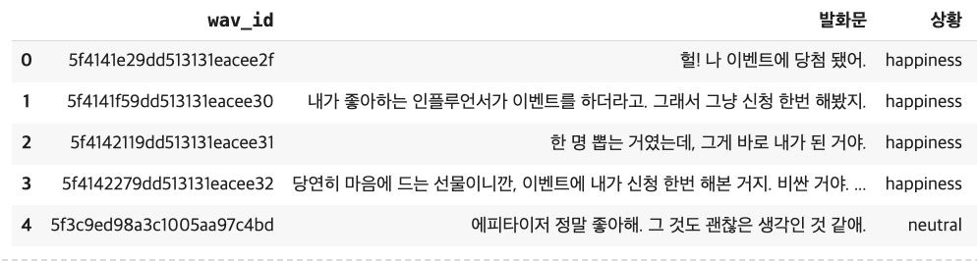
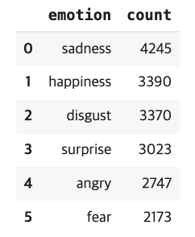
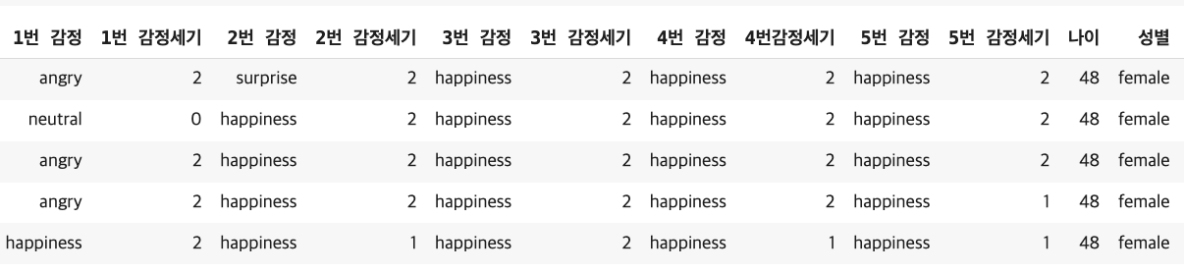
DATA REVIEW

Slide 11
PREPROCESSING
DATA

Slide 12

LABELING
weighted voting
emotion
intensity
main
emotion
1
.
.
.
.
.
.
voting
emotion
intensity
5
weight
main emotion ∈ {happiness, anger, disgust, fear, sadness, surprise}

Slide 13
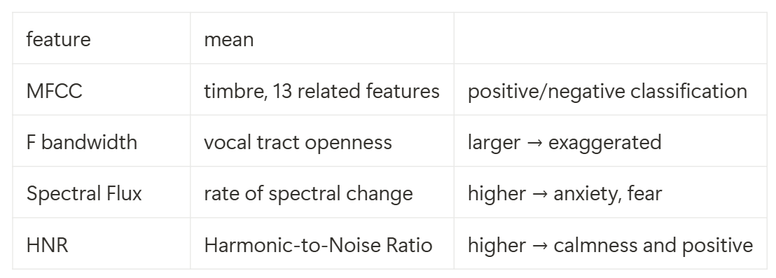
OPEN SMILE
eGeMAPS (88 features)
example
more applicapable to physical properties;
more interpretable compared to other method

Slide 14
IMPROVING METHOD
DATA

Slide 15
IMPROVING METHOD
01
balanced acc across label
02
feature selection

Slide 16
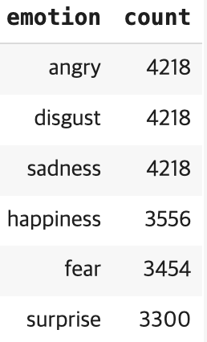
BALALANCED ACC
balanced data set
extra data
new
5.2th
4th
17,531 > 22,964
smote
sampling
modified down
down

Slide 17
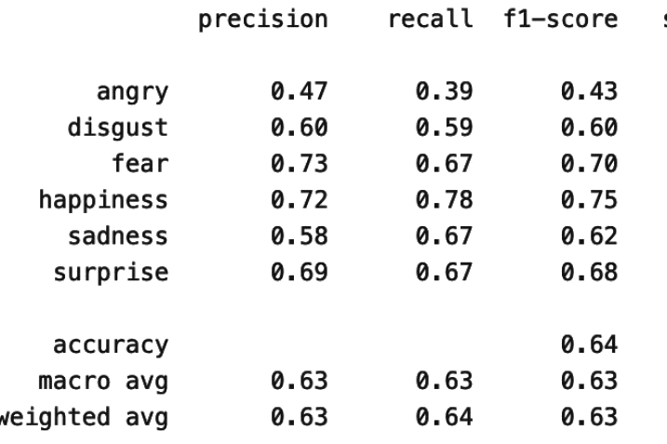
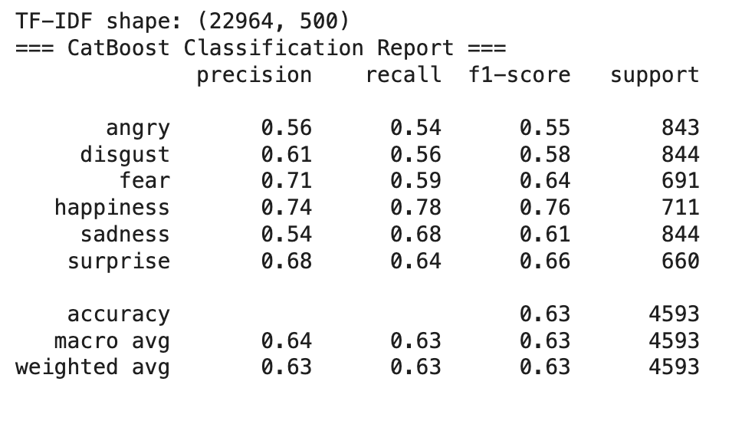
BALALANCED ACC
balanced data set

Slide 18
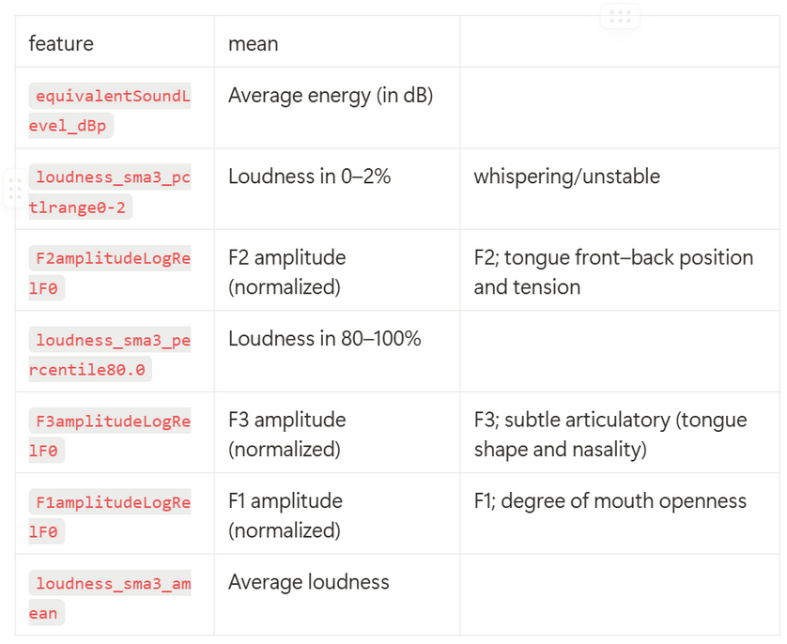
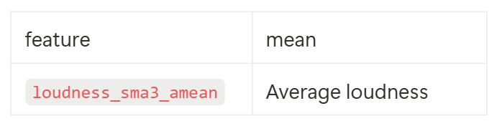
FEATURE SELECTION
feature importance < 0.5
/
overall
intersection of emotion-specific

Slide 19
MODEL COMPARISON
MODELING

Slide 20

MODEL COMPARISON
Precision
 | angry | disgust | fear | happiness | sadness | surprise
Logistic Regression | 0.23 | 0.27 | 0.27 | 0.31 | 0.32 | 0.31
Random Forest | 0.25 | 0.28 | 0.42 | 0.37 | 0.33 | 0.31
Decision Tree | 0.19 | 0.25 | 0.21 | 0.25 | 0.27 | 0.24
SVM | 0 | 0.19 | 0 | 0.21 | 0.25 | 0.29
AdaBoost | 0 | 0.67 | 0.93 | 0.26 | 0.39 | 0.6
CatBoost | 0.51 | 0.56 | 0.76 | 0.69 | 0.55 | 0.67

Slide 21
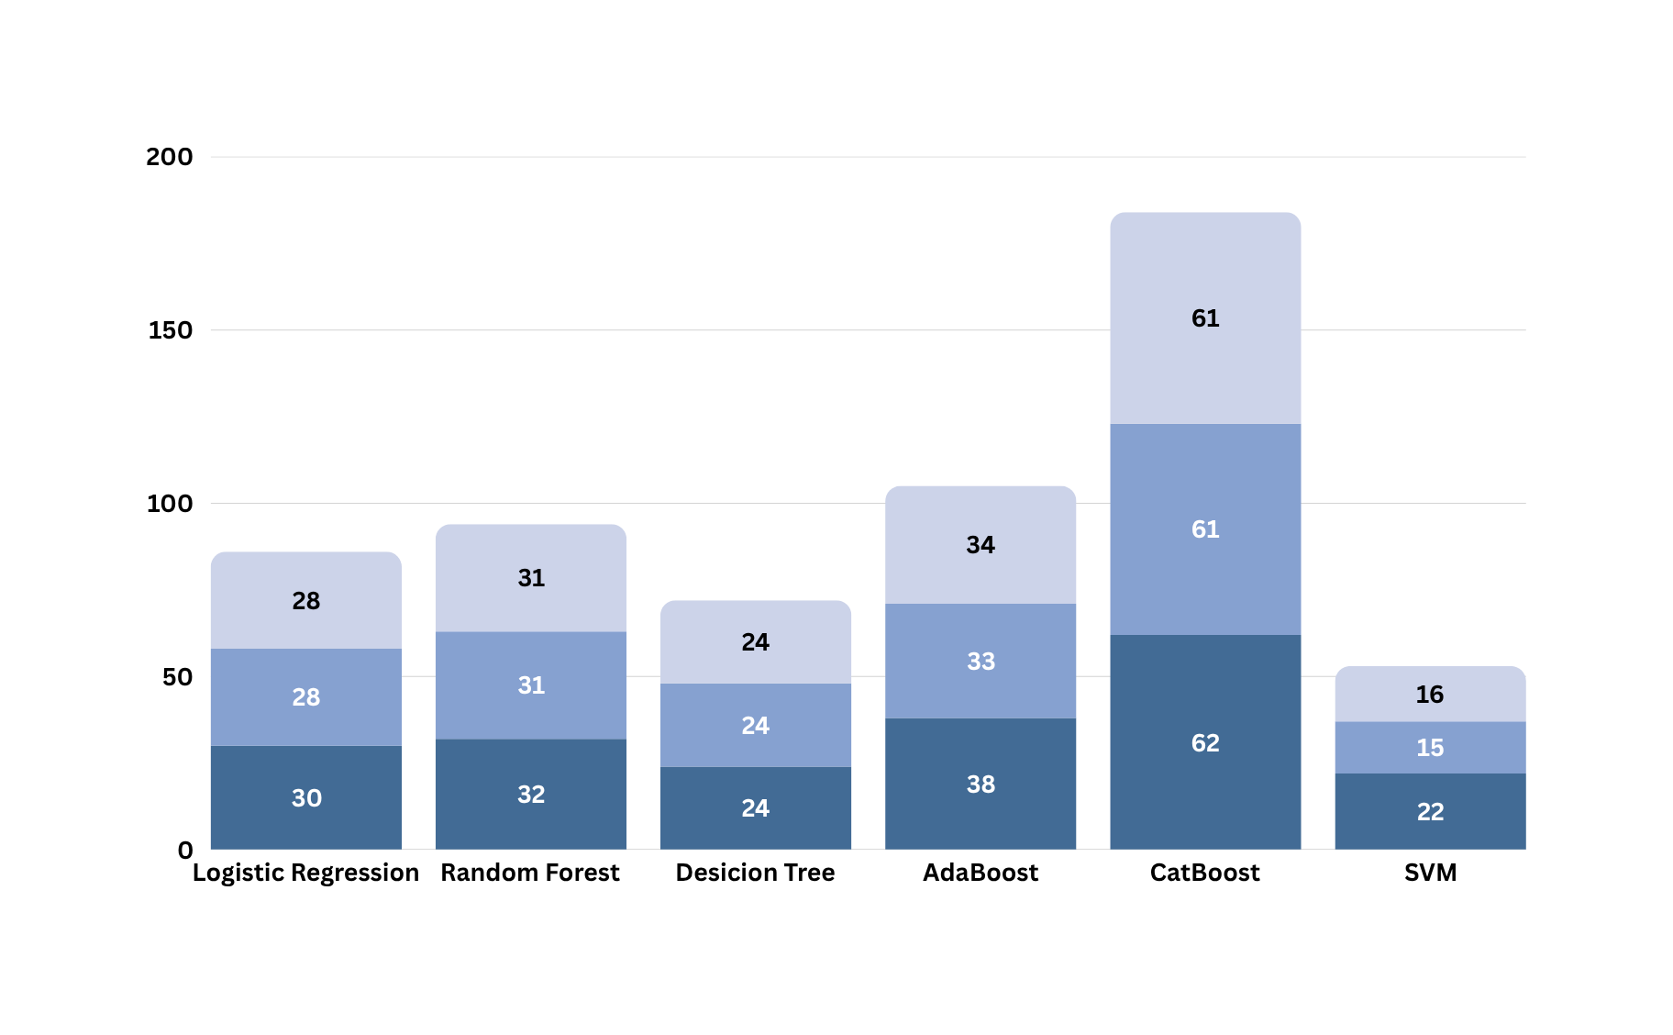
MODEL COMPARISON
F1-score
weighted avg
micro avg
Accuracy

Slide 22
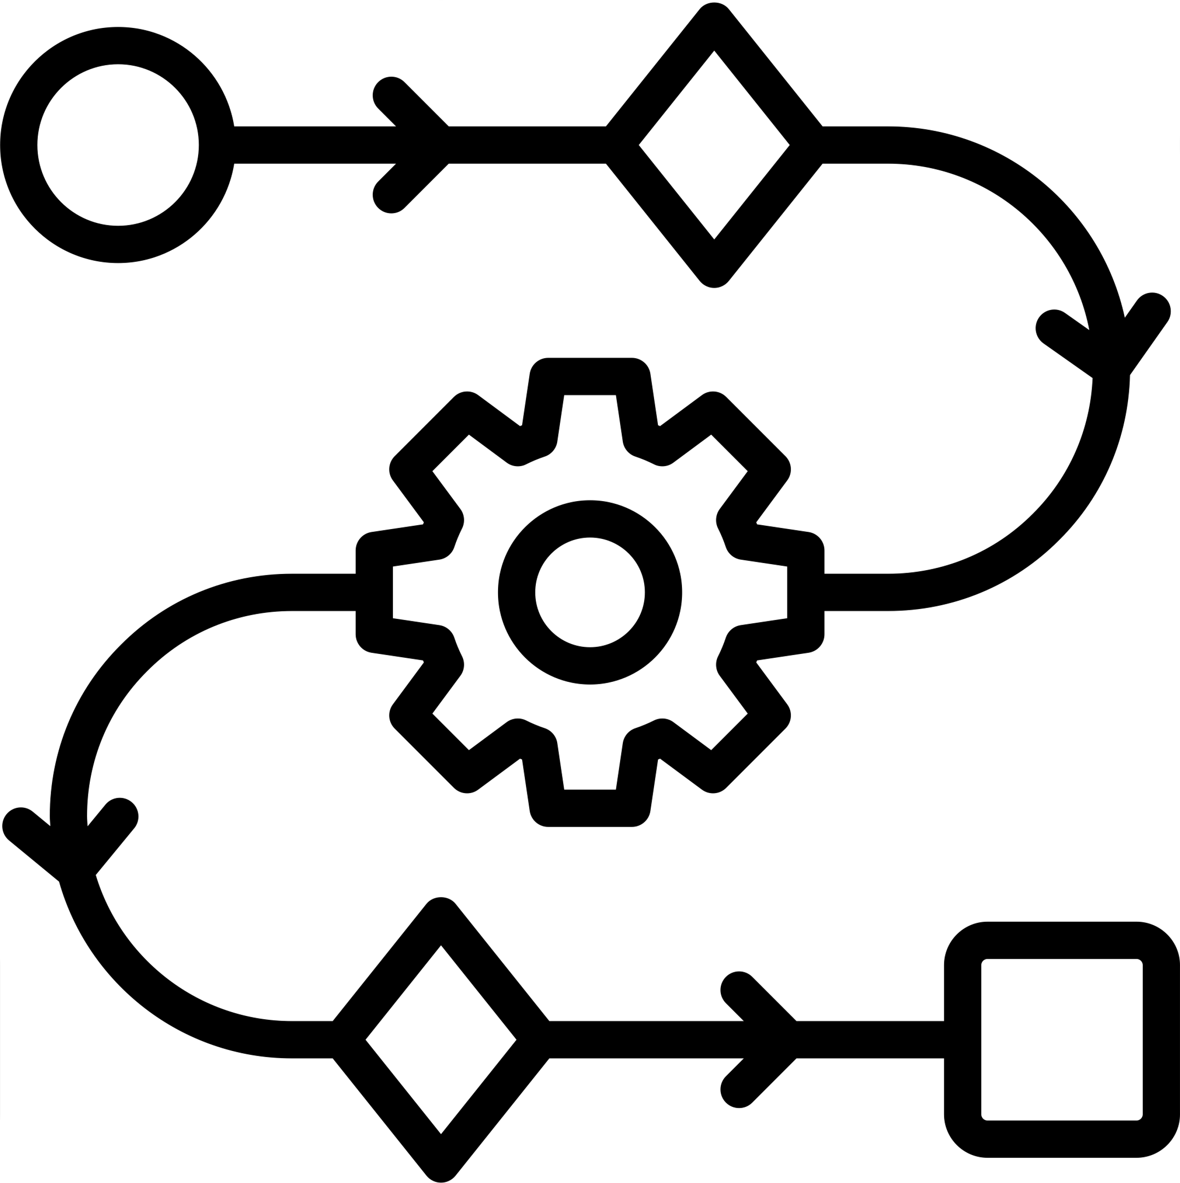
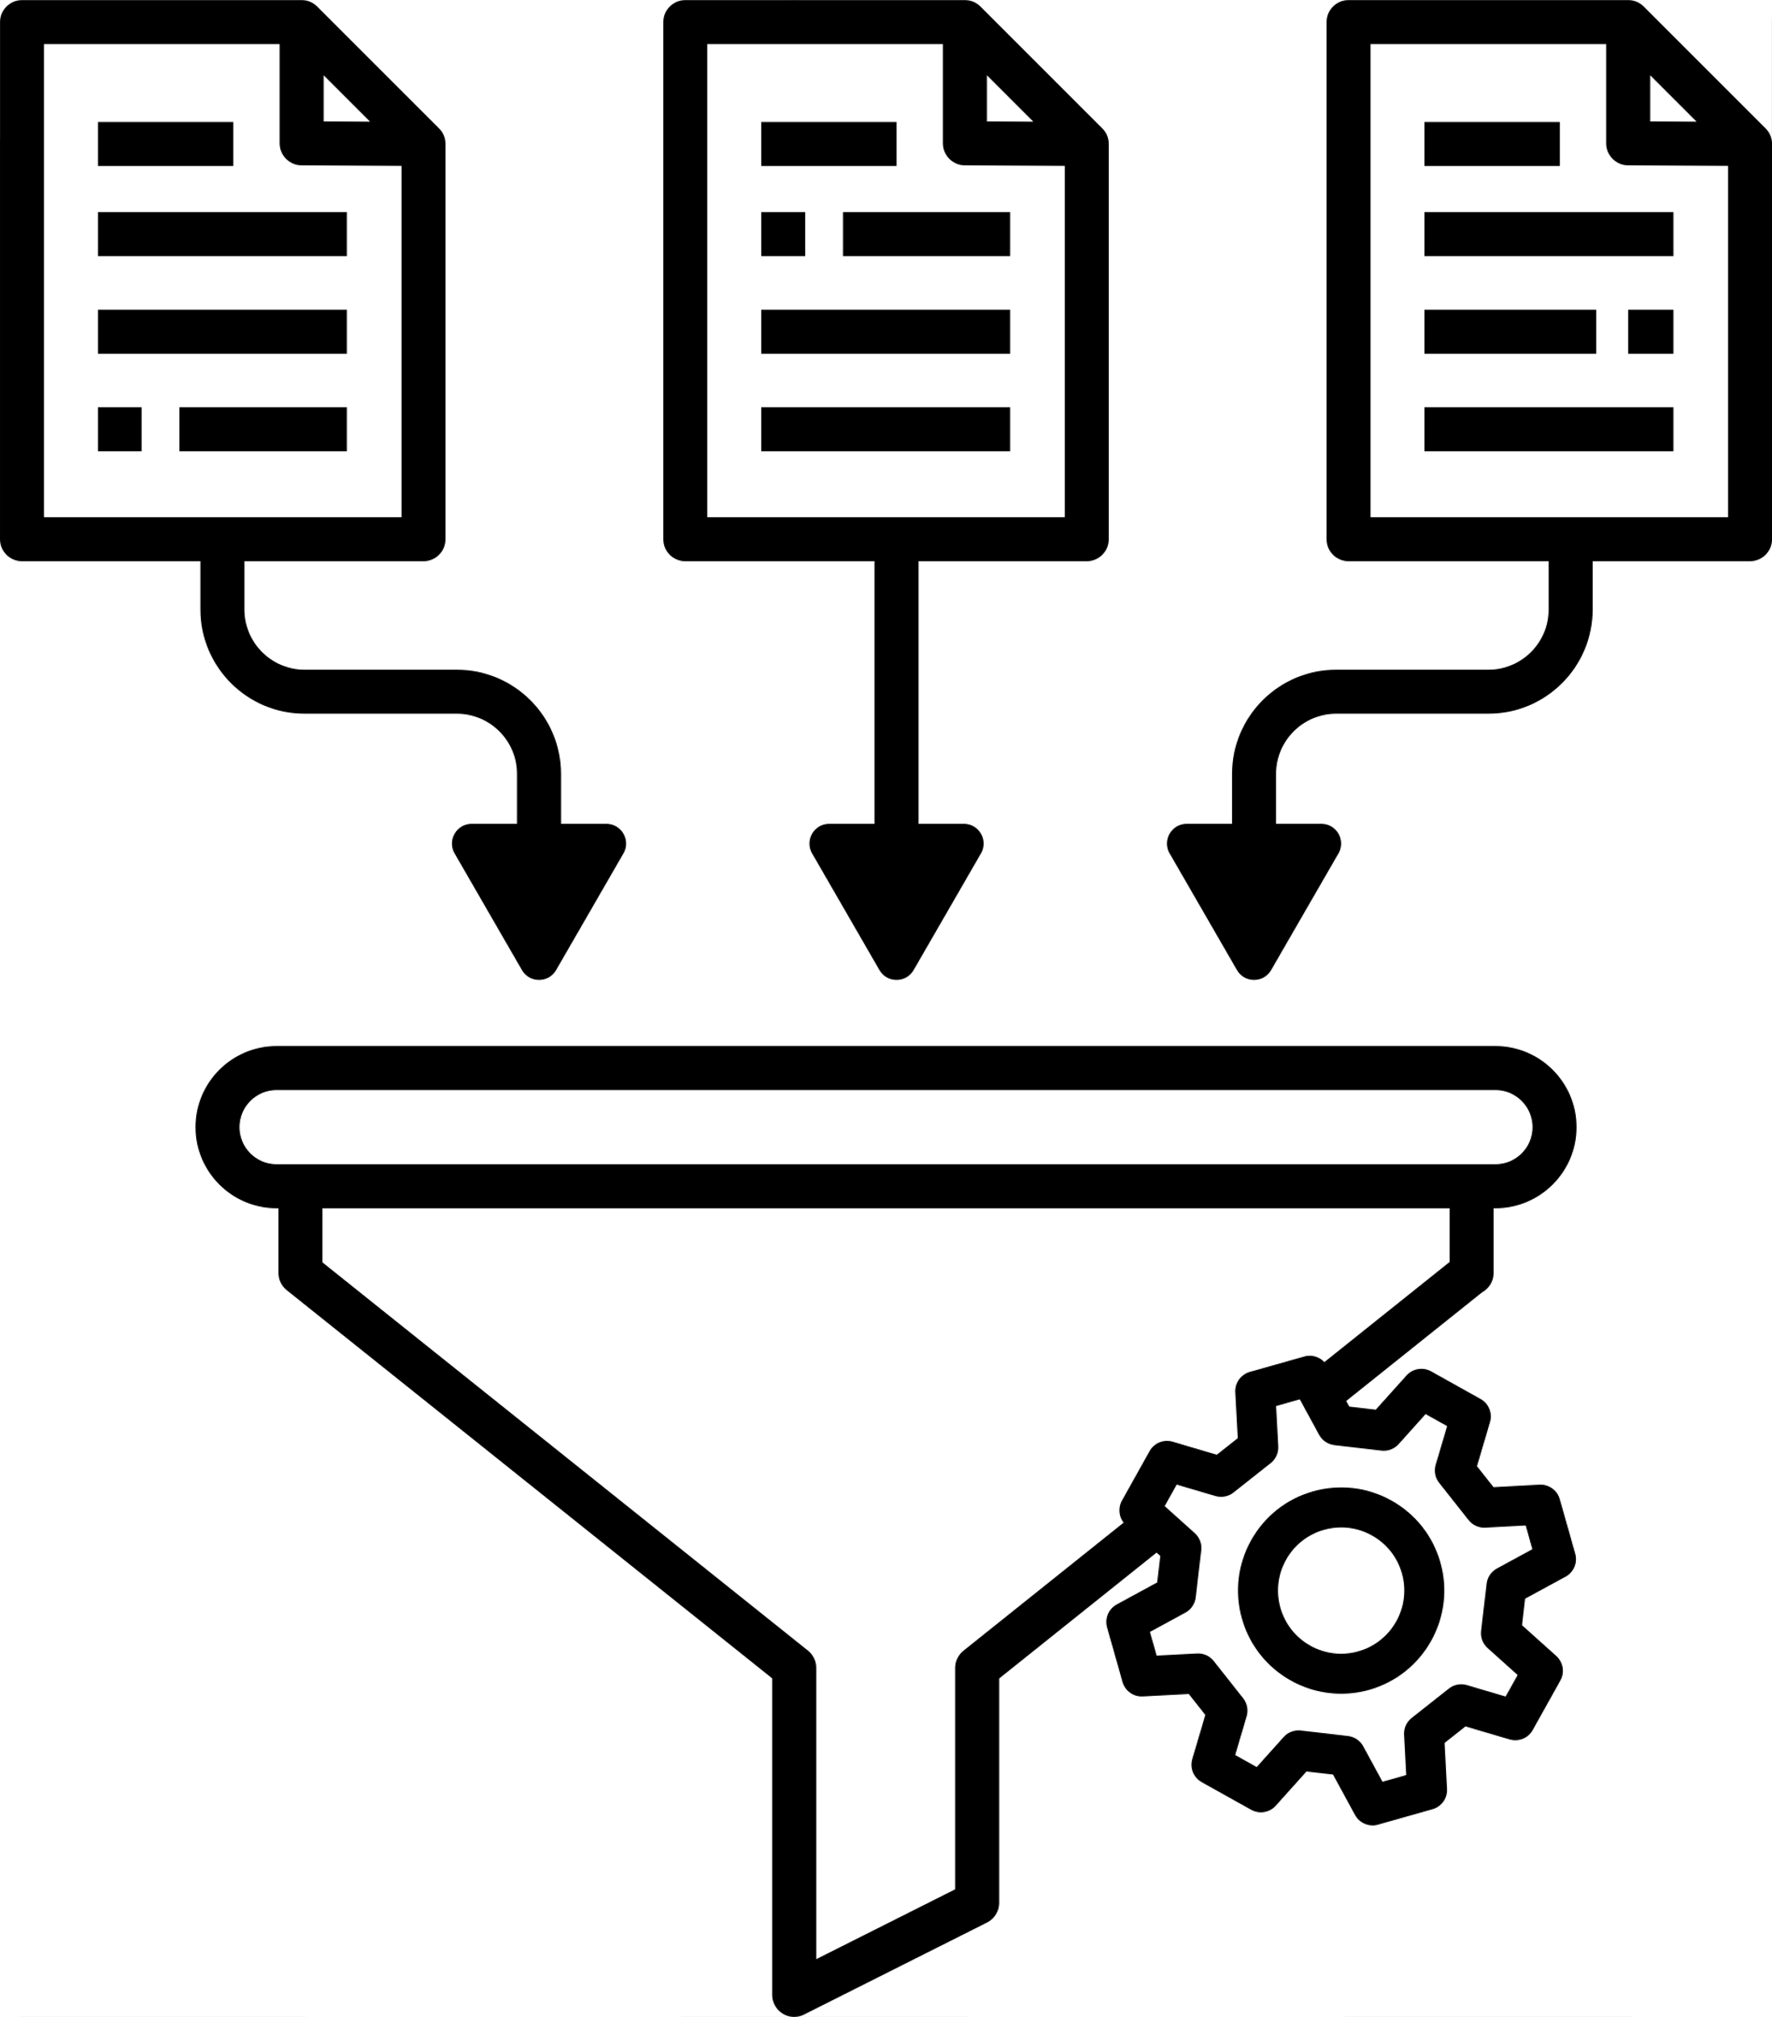

CAT BOOST
Automatic Processing
Built-in Regularization
Fast speed
no need to encoding
prevent overfitting
GPU + parallel

Slide 23
IMPROVING METHOD
MODELING

Slide 24
IMPROVING METHOD
01
Okt vs Mecab
02
Early Fusion vs Late Fusion

Slide 25
OKT VS MECAB
 | Okt | MeCab (mecab-ko)
Speed | Moderate | Very fast
Tokenization Unit | Word-based + whitespace handling | Fine-grained morpheme segmentation
POS tag | about 15 tags | over 50 tags
Korean OOV | Simple whitespace-based | Dictionary-based (ipa-ko) + custom dictionaries

Slide 26
OKT VS MECAB
인공지능기반음성감정분석모델이 구현되었다.
Okt | ['인공지능기반음성감정분석모델', '이', '구현', '되', '었', '다', '.']
MeCab | ['인공', '지능', '기반', '음성', '감정', '분석', '모델', '이', '구현', '되', '었', '다', '.']

Slide 27

EARLY FUSION VS LATE FUSION
classifier
combine
classifier
classifier
Text
Text
Early Fusion
Late Fusion

Slide 28

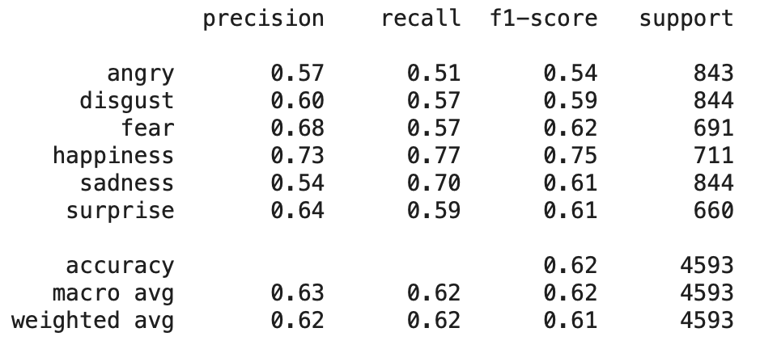
EARLY FUSION VS LATE FUSION
Early Fusion
Late Fusion
acc : 63 %
acc : 62%

Slide 29
FINAL RESULTS

Slide 30
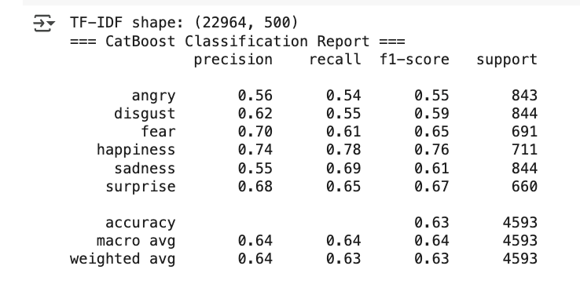
FINAL RESULTS

Slide 31
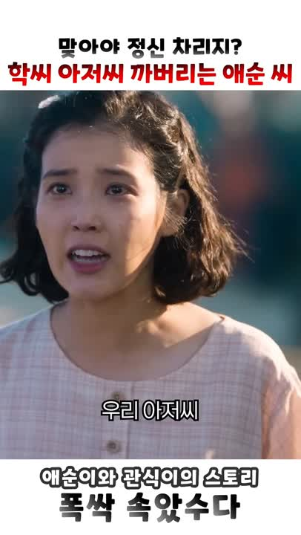
FINAL RESULTS
-PREDICTION
UTTERANCE
“도동리서 배 탈 생각도 말아라! 저걸, 확씨."
TRUTH LABEL
“ANGRY”
PREDICTED LABEL
“ANGRY”

Slide 32

FINAL RESULTS
-PREDICTION
UTTERANCE
“제발 그만해, 나, 나 무서워.
이러다가는 다 죽어!"
TRUTH LABEL
“FEAR”
PREDICTED LABEL
“FEAR”

Slide 33
FUTUTE DIRECTION

Slide 34
FUTUTE DIRECTION
01
Limitations of Machine Learning
02
OpenSMILE; Increased Feature Dimensionality

Slide 35
THANK YOU

Slide 36
Q&A

